Slide 1




Healthcast Forecasting health outcomes using data science.
Omar Smith Eugene Cruz Alfredo Castañeda
March 29, 2024

Slide 2

TABLE OF CONTENTS
What is the Project about?
Important Statistics
Key Aspects of Project
The Platform/Architecture
The Challenges/Next Features
Summary/Questions

Slide 3
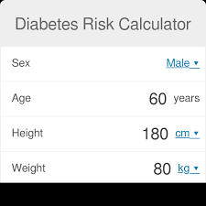

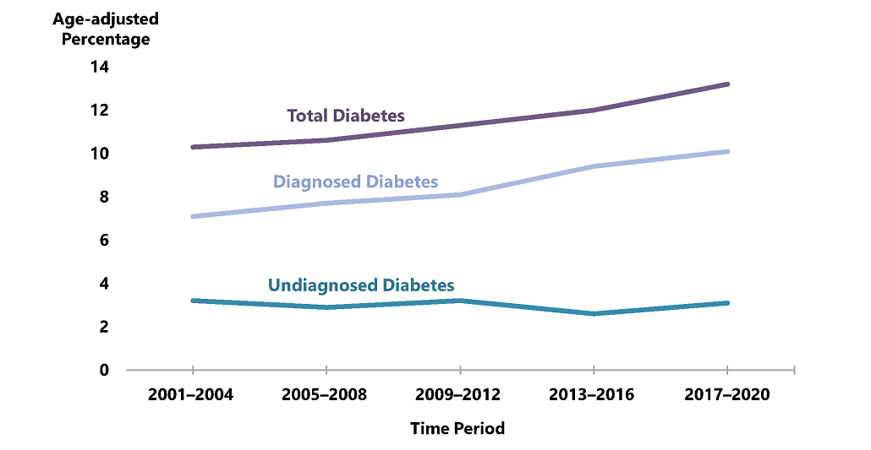

What is this project about?

Slide 4
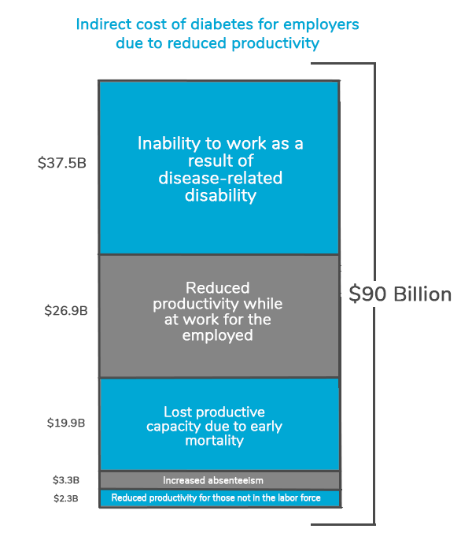
Diabetes Statistics for US
97.6 million people adults have prediabetes
7.86 million hospital discharges
$413 billion total direct/indirect estimated costs
Type 2 diabetes is associated with a higher risk of developing certain tumors.
Sources:
CDC – National Diabetes Statistics Report
Premise Health - The Cost of Diabetes in Seven Graphs

Slide 5
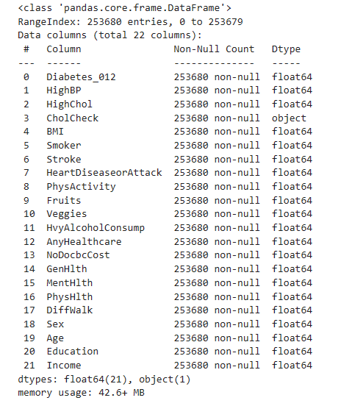
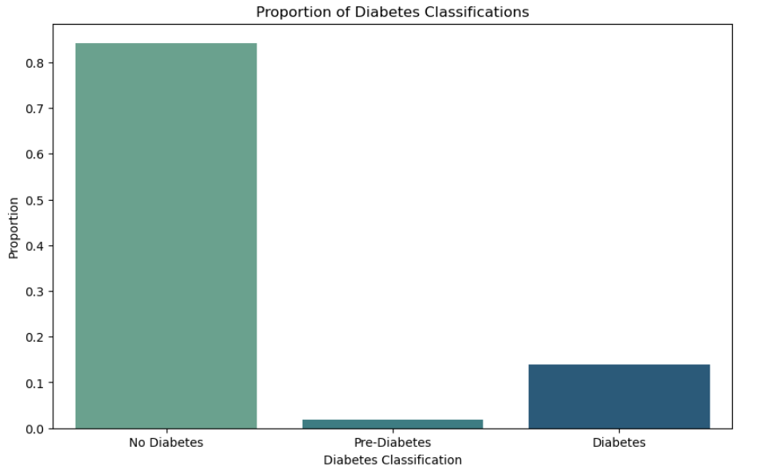
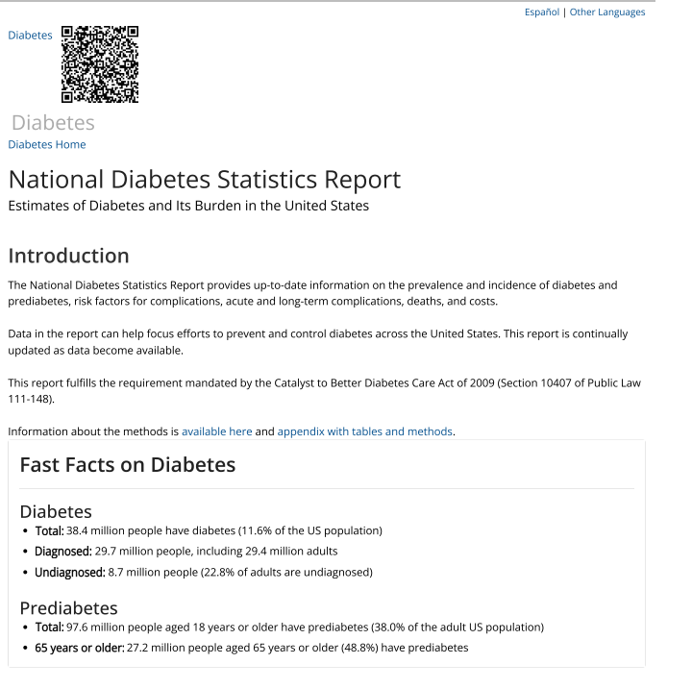
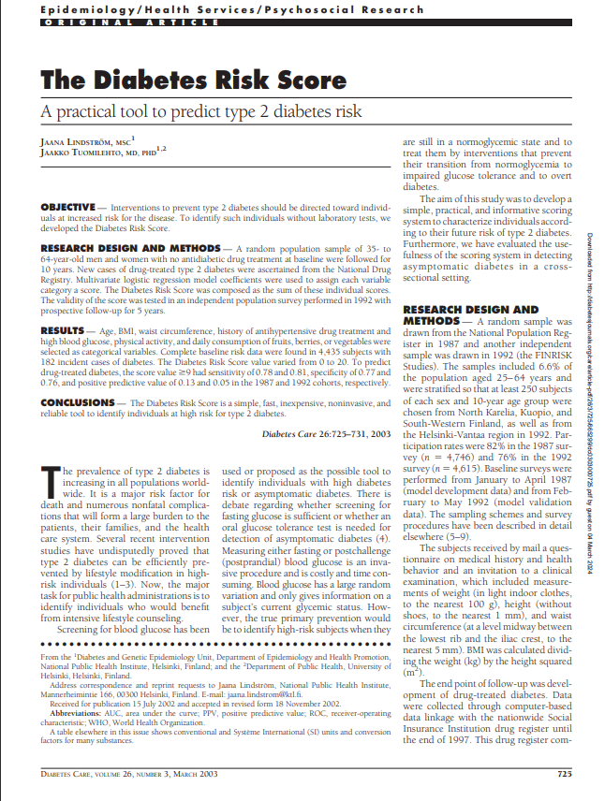
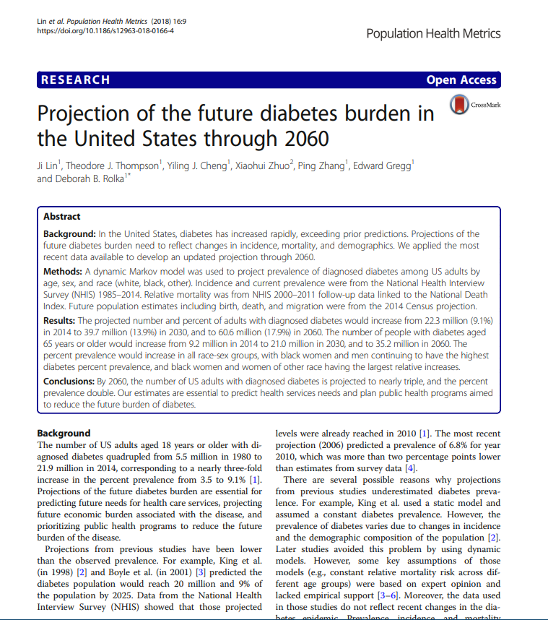
Key Aspects of Project
Survey Data
Size of Data Set
Imbalance
Sufficient information for Context

Slide 6






Building the App
Python Libraries w/ capability for SQL DB
Simple easy to upgrade, and scale

Slide 7
DEMO
https://healthcastdiabetesrisk.streamlit.app

Slide 8
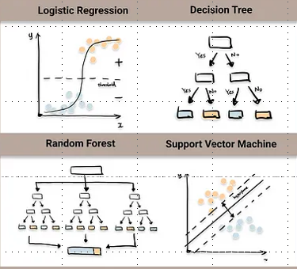
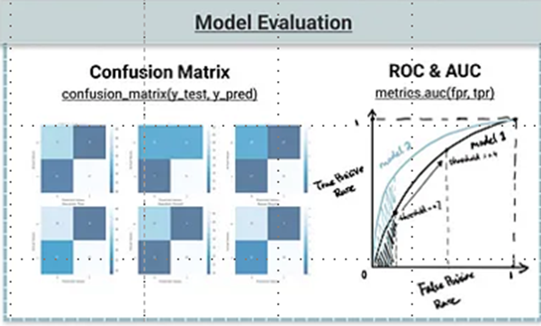

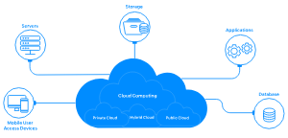

Challenges / Next Features
Feature Selection
Model Evals
Front End vs Backend, Containers / Cloud
Database for data collection/reports
Notes:
Talk about how we overcame these setbacks.
How do you see your future as a Data Scientist / ML Eng? What do you want to achieve now? How did this project inspire/motivate you?

Slide 9

Thank You! Special thanks to

